Slide 1
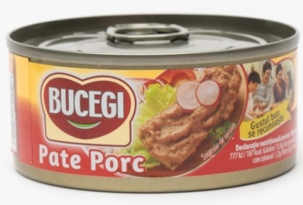
PATE DE PORC BUCEGI
CAREEFOUR CORA AUCHAN MEGA IMAGE LA COCOS
3.25 3.69 3.55 3.57 2.99

Slide 2
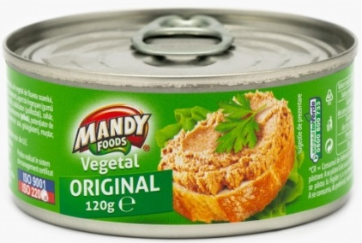
MANDY PATE VEGETAL
CAREEFOUR CORA AUCHAN MEGA IMAGE LA COCOS 3.69 3.69 2.50 3.67 2.69

Slide 3
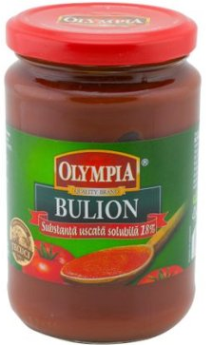
OLYMPIA BULION
CAREEFOUR CORA AUCHAN MEGA IMAGE LA COCOS
5.89 4.69 4.55 5.50 2.99

Slide 4
OLYMPIA PASTA DE TOMATE
CAREEFOUR CORA AUCHAN MEGA IMAGE LA COCOS
7.99 8.01 7.35 7.73 3.89

Slide 5
SULTAN BULION
310 G
CAREEFOUR CORA AUCHAN MEGA IMAGE LA COCOS 5.89 6.09 5.10 (190G) ------ 4.19
…….. NU AU PRODUSUL LA VANZARE

Slide 6
SULTAN PASTA DE TOMATE
400 G
CAREEFOUR CORA AUCHAN MEGA IMAGE LA COCOS 9.78 10.19 (310G) 9.15 10.59 (310G) 6.49

Slide 7
ZACUSCA VINETE B. TOPOLOVENI
CAREEFOUR CORA AUCHAN MEGA IMAGE LA COCOS
7.40 7.92 7.75 7.77 3.29

Slide 8
DULCEATA DE CAPSUNI B. TOPOLOVENI
CAREEFOUR CORA AUCHAN MEGA IMAGE LA COCOS
10.92 11.09 10.40 11.30 4.19

